Slide 1
Final Report
Presented by:
Ricard Maeso Orti
Pablo Ballesteros Martín
Supervisor:
Dr. Joseph Morlier

Slide 2
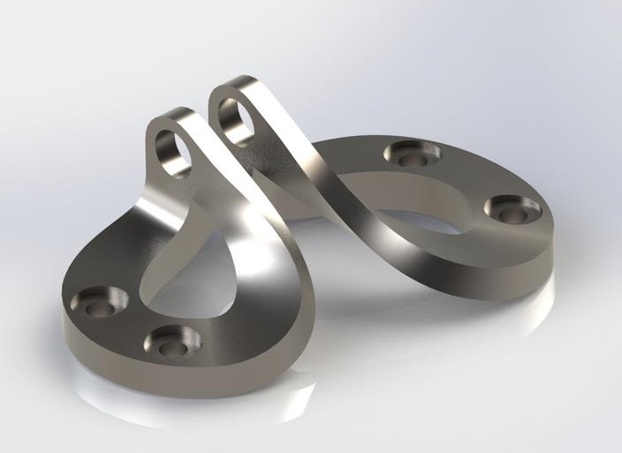
Outline
Introduction
State of the art
Methodology
Results
Interactive Website
Conclusions
Fig 1 : Brackets from SimJEB database. Image: Whalen, E., Beyene, A. and Mueller, C. (2021), SimJEB: Simulated Jet Engine Bracket Dataset. Computer Graphics Forum, 40: 9-17.

Slide 3
Introduction
Lightweight Structures & Sustainability
Optimization Challenge
Traditional method:
Research Objectives
Identify strategic materials for aerospace.
Sequential optimization
Better approach:
Coupled variables
Minimize environmental impact
Key design variables:
Geometry
Material Selection.
Predict optimal mechanical and environmental performance.
Notes:
The aim of the surrogate model is being capable of determining a function such as when some inputs are introduced, it can be able tod etermine the CO2. As an inputs we have the materials and the training data. For the inputs it would be the materials and their properties and some other parameters that are needed to be able to optimize the problem. The final goal is to find a plot in which we can find the deformation – CO2 emmited. For our project we intend to do 200 simulated samples with 5 or 6 materials each. Due to the high number of simulations we will use the High Performance Computer of ISAE SUPAERO. In the surrogate we will use a method included in the SMT library like a Bayessian optimization method .
First the CAD file will need to be optimized for 4 load cases and the deformations will be computed.

Slide 4
STATE OF THE ART

Slide 5
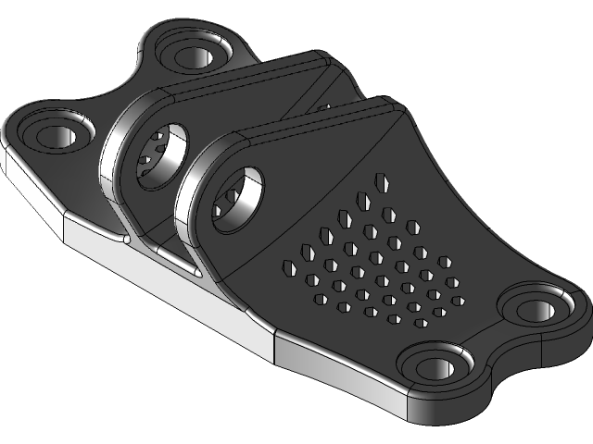
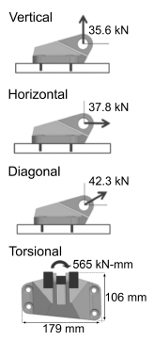
SimJEB Library
Public collection of mechanical brackets
Simulations
+300 brackets
Same bolts, interface and engineering task
Ti-6Al-4V
Manufacturability
Fig 2 : Loads applied to the Brackets. Image: Whalen, E., Beyene, A. and Mueller, C. (2021), SimJEB: Simulated Jet Engine Bracket Dataset. Computer Graphics Forum, 40: 9-17.

Slide 6
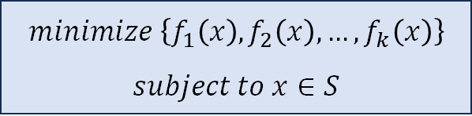



Multi-Objective Optimization
Vector of objective functions
Modern engineering demands
Trade-off between conflicting objectives
$$f\left(x\right)={\left(f_{1}\left(x\right),f_{2}\left(x\right),…,f_{k}\left(x\right)\right)}^{T}$$
Decision variable vector
$$x={\left(x_{1},x_{2},…,x_{n}\right)}^{T}$$
$$minimize \left\{f_{1}\left(x\right), f_{2}\left(x\right),…,f_{k}\left(x\right)\right\}$$
$$subject to x∈S$$
Feasible Region
$$S$$

Slide 7
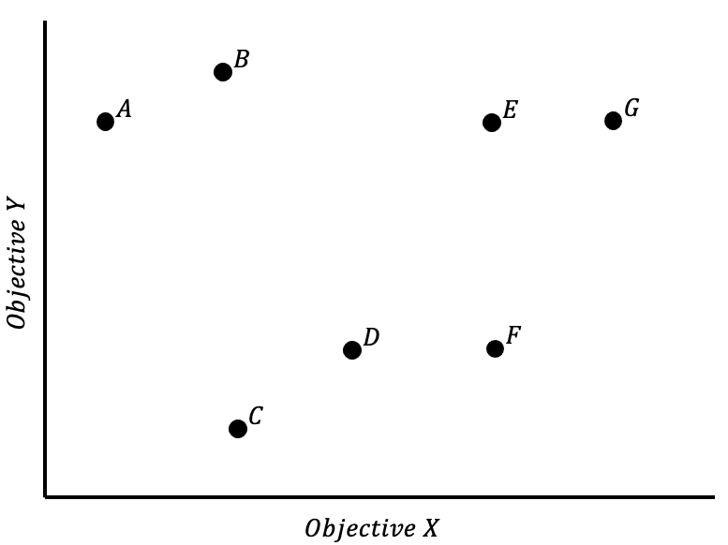



Pareto Optimality
Evaluates the quality of solutions
$$f_{i}\left(x\right)≤f_{i}\left(x^{∗}\right) for all i=1,…,k$$
$$A solution x^{∗}∈ Ω is Pareto optimal if there$$
$$does not exist another solution x∈Ω such that$$
$$f_{j}\left(x\right)<f_{j}\left(x^{∗}\right) for at least one j$$
Set of possible solutions for the optimization problem
Fig 3:

Slide 8
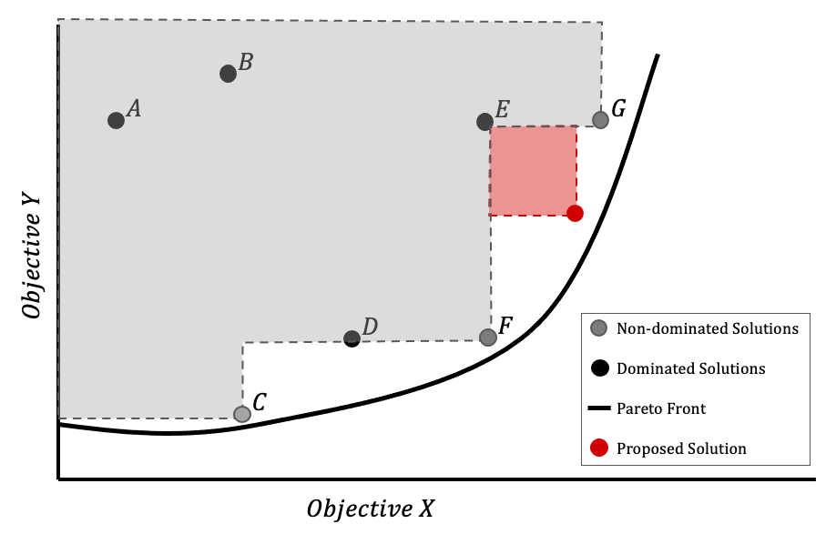
Pareto Optimality
Evaluates the quality of solutions
$$f_{i}\left(x\right)≤f_{i}\left(x^{∗}\right) for all i=1,…,k$$
$$A solution x^{∗}∈ Ω is Pareto optimal if there$$
$$does not exist another solution x∈Ω such that$$
$$f_{j}\left(x\right)<f_{j}\left(x^{∗}\right) for at least one j$$
Pareto front for the optimization problem
Fig 4:

Slide 9
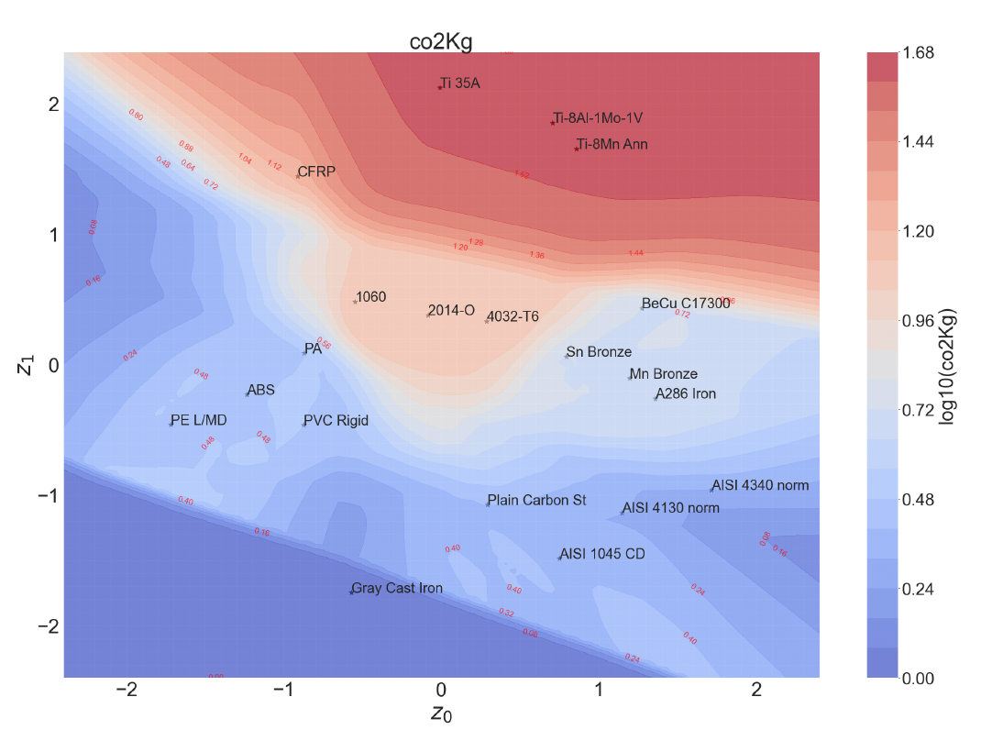











ML for Material Selection
Discrete Variables
Variational Autoencoders
Continuous and
Differentiable Variables
Material Properties
VAEs represent high-dimensional data in a lower-dimensional latent space
Continuous variables enables gradient based algorithms
$$z \sim 𝒩(m=0, σ=1)$$
$$\min_{A_{i}∈A, z_{0},z_{1}}{ψ(A_{i}, …,A_{N},z_{0},z_{1})}$$
$$\min_{A_{i}∈A, m∈M}{ψ(A_{i}, …,A_{N},ζ_{m})}$$
$$K\left(A_{1},…,A_{N},z_{0},z_{1}\right)u=f$$
$$K\left(A_{1},…,A_{N},E_{m}\right)u=f$$
$$g\left(A_{1},…,A_{N},z_{0},z_{1}\right)≤0$$
$$g\left(A_{1},…,A_{N},ζ_{m}\right)≤0$$
$$A_{min}≤A≤A_{max}$$
$$A_{min}≤A≤A_{max}$$
$$z_{0,min}≤z_{0}≤z_{0,max }$$
$$z_{1,min}≤z_{1}≤z_{1,max }$$
Fig 5 : 2-D latent space. Image: Luis Yepes Llorente, Joseph Morlier, et al. “A Hybrid Machine Learning and Evolutionary Approach to Material Selection and Design Optimization for Eco-Friendly Structures.”
Notes:
The aim of the surrogate model is being capable of determining a function such as when some inputs are introduced, it can be able tod etermine the CO2. As an inputs we have the materials and the training data. For the inputs it would be the materials and their properties and some other parameters that are needed to be able to optimize the problem. The final goal is to find a plot in which we can find the deformation – CO2 emmited. For our project we intend to do 200 simulated samples with 5 or 6 materials each. Due to the high number of simulations we will use the High Performance Computer of ISAE SUPAERO. In the surrogate we will use a method included in the SMT library like a Bayessian optimization method .
First the CAD file will need to be optimized for 4 load cases and the deformations will be computed.

Slide 10
METHODOLOGY

Slide 11
Workflow
1. Material Selection
2. SimJEB configuration
3. Finite Element Analysis
4. Computation of environmental quantities
5. Pareto Front Optimization
6. Interactive website
Notes:
The aim of the surrogate model is being capable of determining a function such as when some inputs are introduced, it can be able tod etermine the CO2. As an inputs we have the materials and the training data. For the inputs it would be the materials and their properties and some other parameters that are needed to be able to optimize the problem. The final goal is to find a plot in which we can find the deformation – CO2 emmited. For our project we intend to do 200 simulated samples with 5 or 6 materials each. Due to the high number of simulations we will use the High Performance Computer of ISAE SUPAERO. In the surrogate we will use a method included in the SMT library like a Bayessian optimization method .
First the CAD file will need to be optimized for 4 load cases and the deformations will be computed.

Slide 12
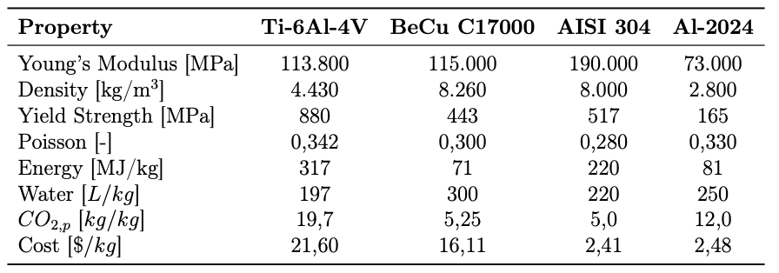

Material Selection
Mechanical
(Specific )
Environmental
Table 1 : Material Properties
$CO_{2}=CO_{2}^{prod}+CO_{2}^{use}=CO_{2}^{prod}+98.8\frac{t CO_{2}}{kg}·M$
From: Edouard Duriez, Joseph Morlier, Catherine Azzaro-Pantel, M. Charlotte. Ecodesign with topology optimization.
Notes:
The aim of the surrogate model is being capable of determining a function such as when some inputs are introduced, it can be able tod etermine the CO2. As an inputs we have the materials and the training data. For the inputs it would be the materials and their properties and some other parameters that are needed to be able to optimize the problem. The final goal is to find a plot in which we can find the deformation – CO2 emmited. For our project we intend to do 200 simulated samples with 5 or 6 materials each. Due to the high number of simulations we will use the High Performance Computer of ISAE SUPAERO. In the surrogate we will use a method included in the SMT library like a Bayessian optimization method .
First the CAD file will need to be optimized for 4 load cases and the deformations will be computed.

Slide 13
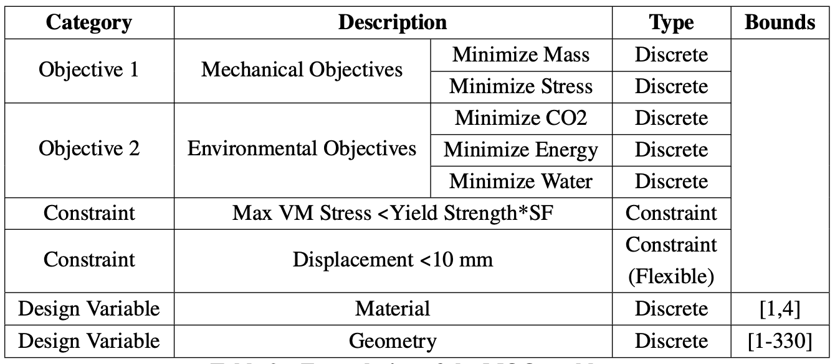






Problem Formulation
$$\min_{x}{[f_{1}\left(x\right), f_{2}\left(x\right) … f_{N}\left(x\right)]}$$
$$subjected to :$$
$$g_{1}\left(x\right)=−σ\left(x\right)+\frac{σ_{yield}}{SF}≤0$$
$$g_{2}\left(x\right)=u_{max}−10≤0$$
$$where :$$
Table 2 : Pareto Front Optimization Formulation
$$x=[x_{geom} x_{mat}]$$
Notes:
The aim of the surrogate model is being capable of determining a function such as when some inputs are introduced, it can be able tod etermine the CO2. As an inputs we have the materials and the training data. For the inputs it would be the materials and their properties and some other parameters that are needed to be able to optimize the problem. The final goal is to find a plot in which we can find the deformation – CO2 emmited. For our project we intend to do 200 simulated samples with 5 or 6 materials each. Due to the high number of simulations we will use the High Performance Computer of ISAE SUPAERO. In the surrogate we will use a method included in the SMT library like a Bayessian optimization method .
First the CAD file will need to be optimized for 4 load cases and the deformations will be computed.

Slide 14
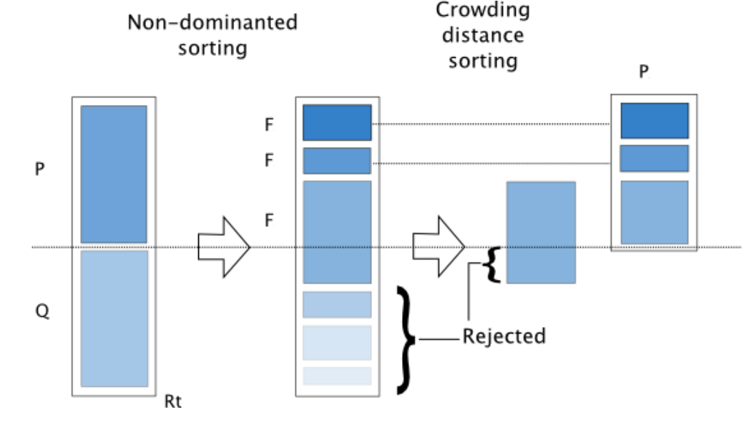
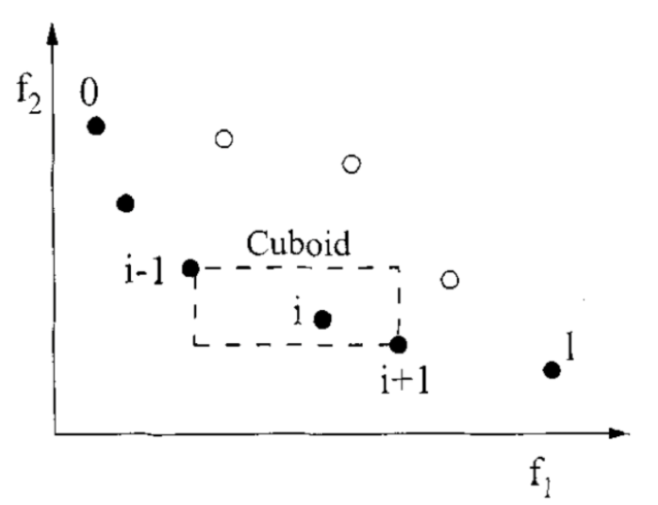
NSGA-2
Genetic algorithm for MOO problems by finding Pareto Fronts
1. Inititalization
2. Non-Dominated Sorting
3. Crowding Distance Assignment
4. Selection
5. Crossvover and mutation
6. Elitism and Survival
Fig. 6: Pareto Front Optimization Formulation [4]
Notes:
The aim of the surrogate model is being capable of determining a function such as when some inputs are introduced, it can be able tod etermine the CO2. As an inputs we have the materials and the training data. For the inputs it would be the materials and their properties and some other parameters that are needed to be able to optimize the problem. The final goal is to find a plot in which we can find the deformation – CO2 emmited. For our project we intend to do 200 simulated samples with 5 or 6 materials each. Due to the high number of simulations we will use the High Performance Computer of ISAE SUPAERO. In the surrogate we will use a method included in the SMT library like a Bayessian optimization method .
First the CAD file will need to be optimized for 4 load cases and the deformations will be computed.

Slide 15
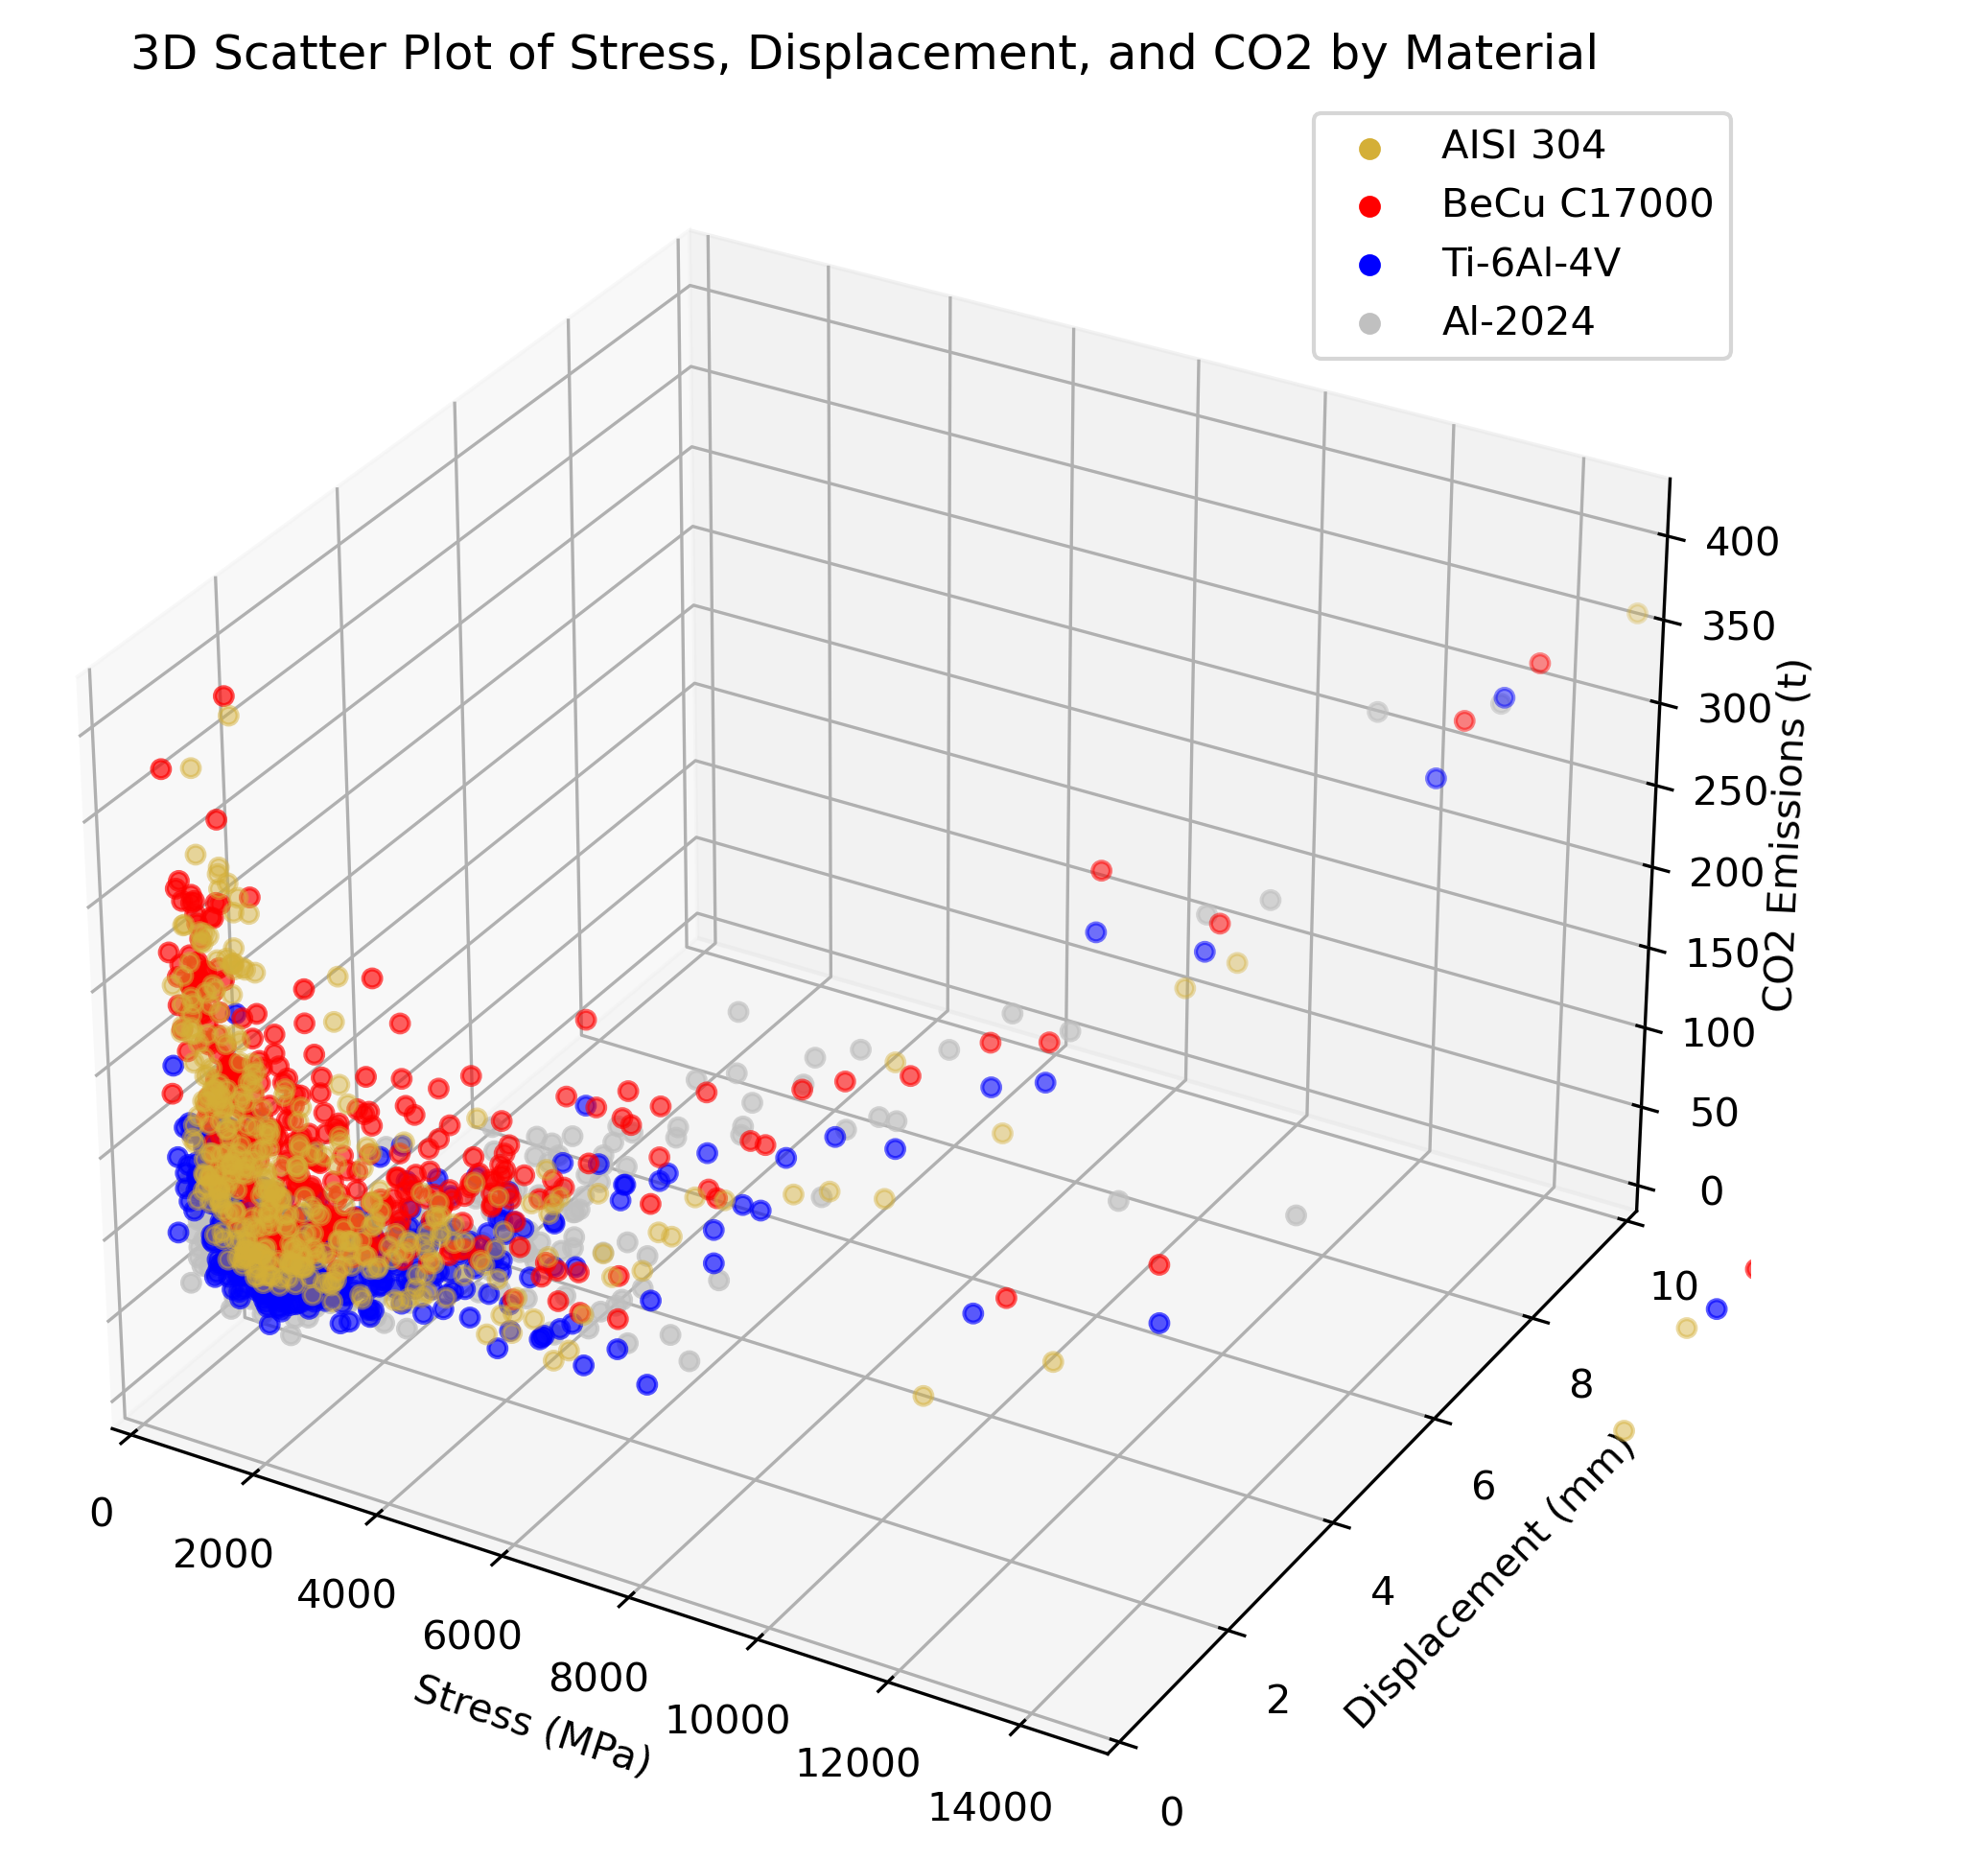
RESULTS
Fig. 7: 3D plot of the baseline results
Notes:
The aim of the surrogate model is being capable of determining a function such as when some inputs are introduced, it can be able tod etermine the CO2. As an inputs we have the materials and the training data. For the inputs it would be the materials and their properties and some other parameters that are needed to be able to optimize the problem. The final goal is to find a plot in which we can find the deformation – CO2 emmited. For our project we intend to do 200 simulated samples with 5 or 6 materials each. Due to the high number of simulations we will use the High Performance Computer of ISAE SUPAERO. In the surrogate we will use a method included in the SMT library like a Bayessian optimization method .
First the CAD file will need to be optimized for 4 load cases and the deformations will be computed.

Slide 16
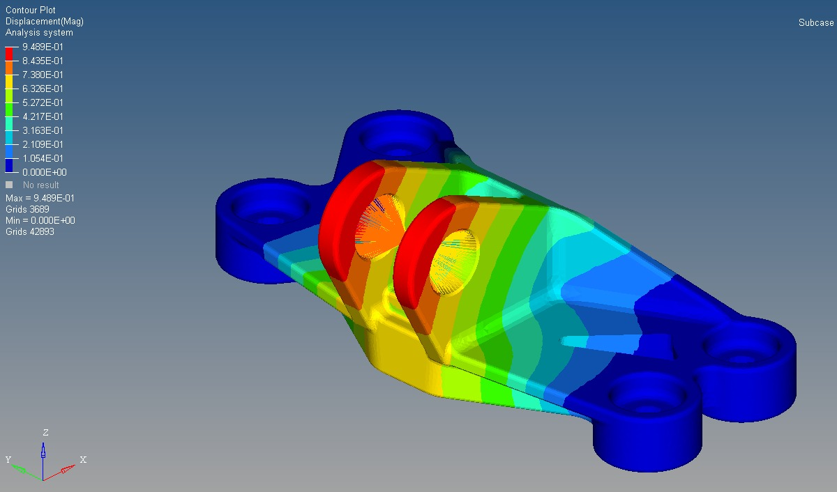
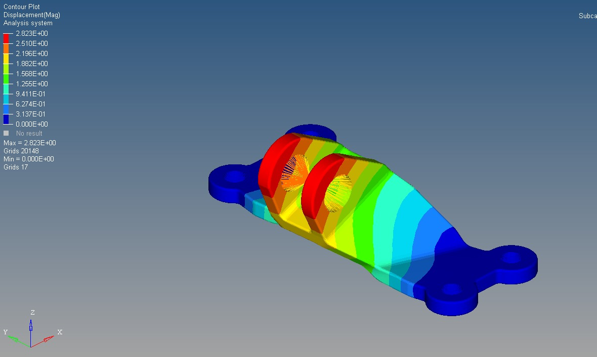
Stress and Displacements
Fig 8 : Displacements for Bracket #135
Fig 9 : Displacements for Bracket #95

Slide 17
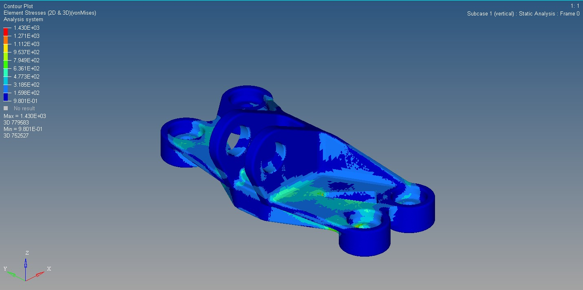
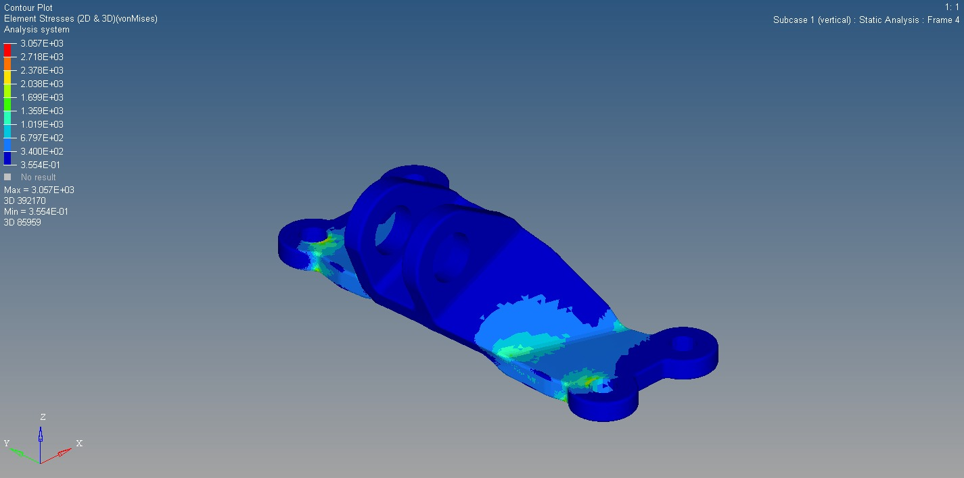
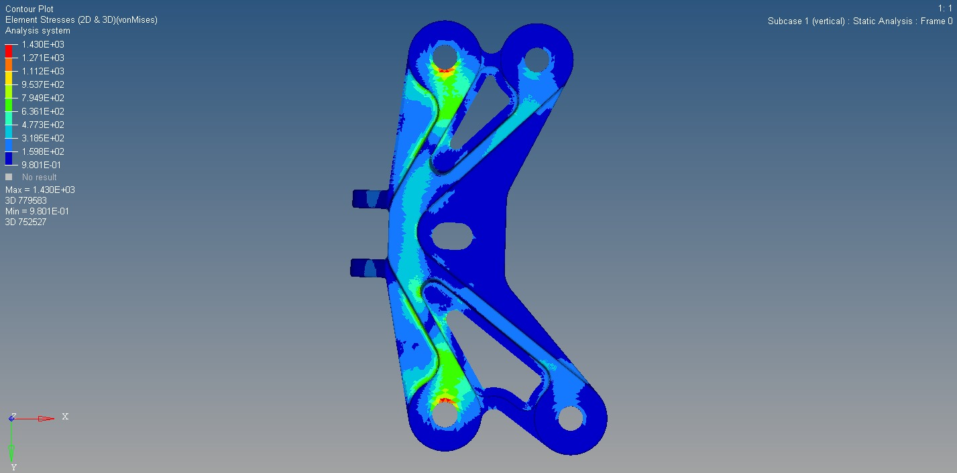
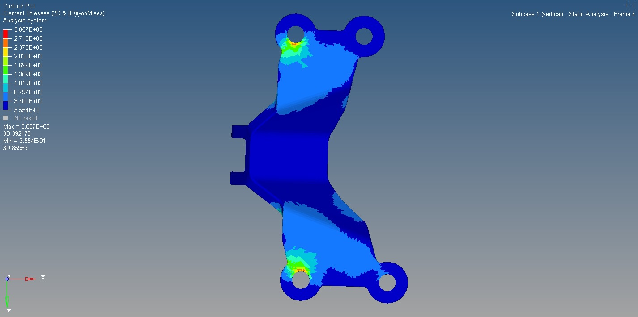
Fig 10 : Stress for Bracket #135
Fig 11 : Stress for Bracket #95
Notes:
The aim of the surrogate model is being capable of determining a function such as when some inputs are introduced, it can be able tod etermine the CO2. As an inputs we have the materials and the training data. For the inputs it would be the materials and their properties and some other parameters that are needed to be able to optimize the problem. The final goal is to find a plot in which we can find the deformation – CO2 emmited. For our project we intend to do 200 simulated samples with 5 or 6 materials each. Due to the high number of simulations we will use the High Performance Computer of ISAE SUPAERO. In the surrogate we will use a method included in the SMT library like a Bayessian optimization method .
First the CAD file will need to be optimized for 4 load cases and the deformations will be computed.

Slide 18

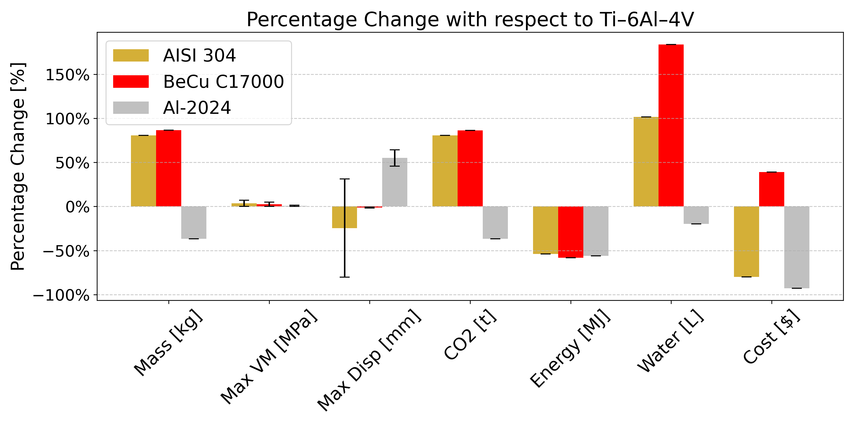

Data Exploration
BeCU C17000 and AISI 304 higher masses
Aluminium shows higher displacements
No differences in stress results
Density and specific emissions of Al-2024 reduces significantly vs Ti-6Al-4V
Alternatives use more water but less energy
Fig 12 : Percentage of change wrt Ti-6Al-4V
Notes:
The aim of the surrogate model is being capable of determining a function such as when some inputs are introduced, it can be able tod etermine the CO2. As an inputs we have the materials and the training data. For the inputs it would be the materials and their properties and some other parameters that are needed to be able to optimize the problem. The final goal is to find a plot in which we can find the deformation – CO2 emmited. For our project we intend to do 200 simulated samples with 5 or 6 materials each. Due to the high number of simulations we will use the High Performance Computer of ISAE SUPAERO. In the surrogate we will use a method included in the SMT library like a Bayessian optimization method .
First the CAD file will need to be optimized for 4 load cases and the deformations will be computed.

Slide 19
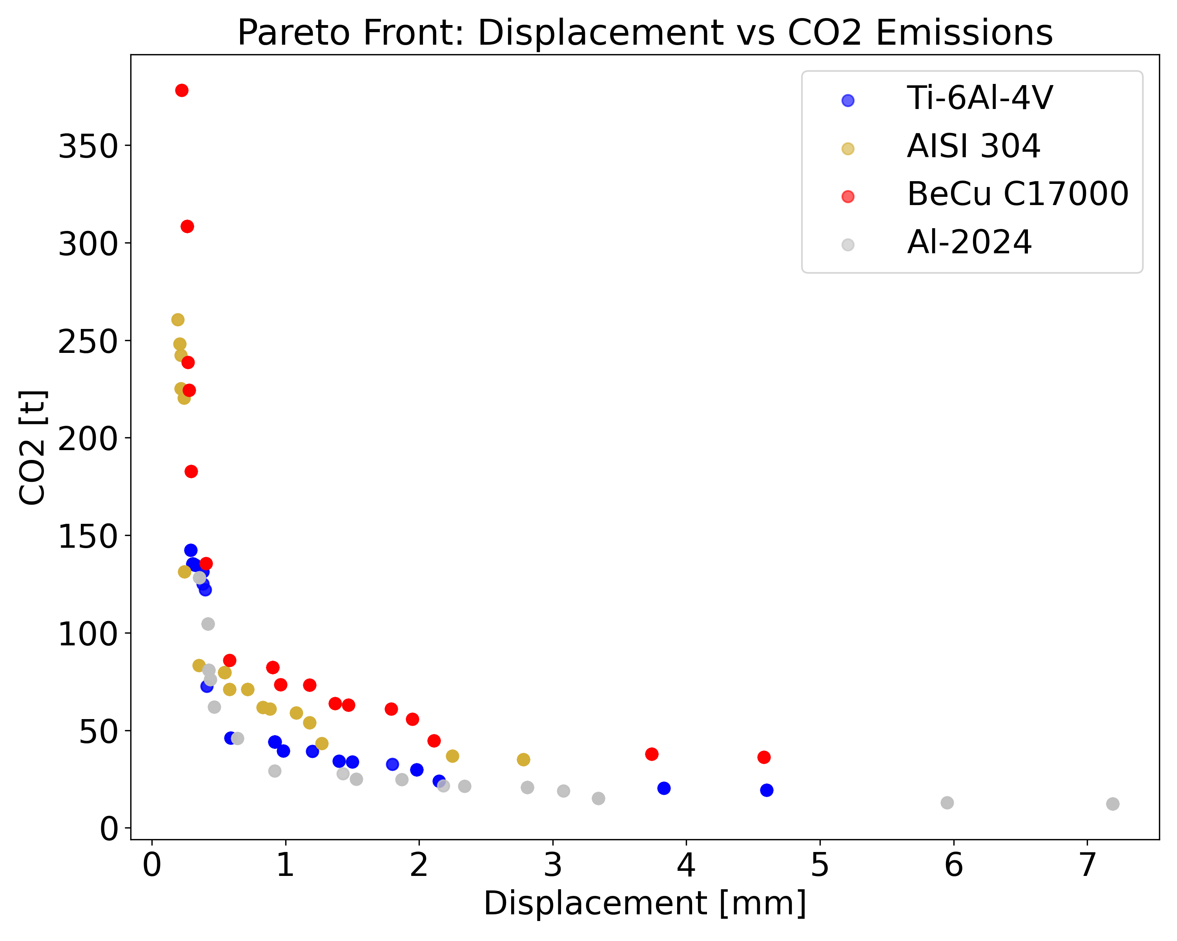
Pareto Front Example
Exponential decay behaviour
Ideal results : Left-bottom side
BeCU C17000 less favourable
Ideal
Fig 13 : 2D Pareto Front
Notes:
The aim of the surrogate model is being capable of determining a function such as when some inputs are introduced, it can be able tod etermine the CO2. As an inputs we have the materials and the training data. For the inputs it would be the materials and their properties and some other parameters that are needed to be able to optimize the problem. The final goal is to find a plot in which we can find the deformation – CO2 emmited. For our project we intend to do 200 simulated samples with 5 or 6 materials each. Due to the high number of simulations we will use the High Performance Computer of ISAE SUPAERO. In the surrogate we will use a method included in the SMT library like a Bayessian optimization method .
First the CAD file will need to be optimized for 4 load cases and the deformations will be computed.

Slide 20
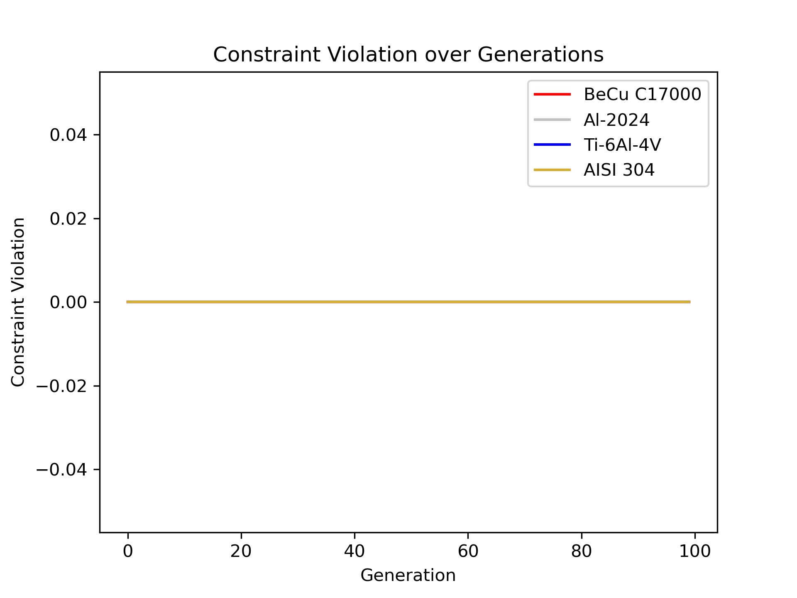
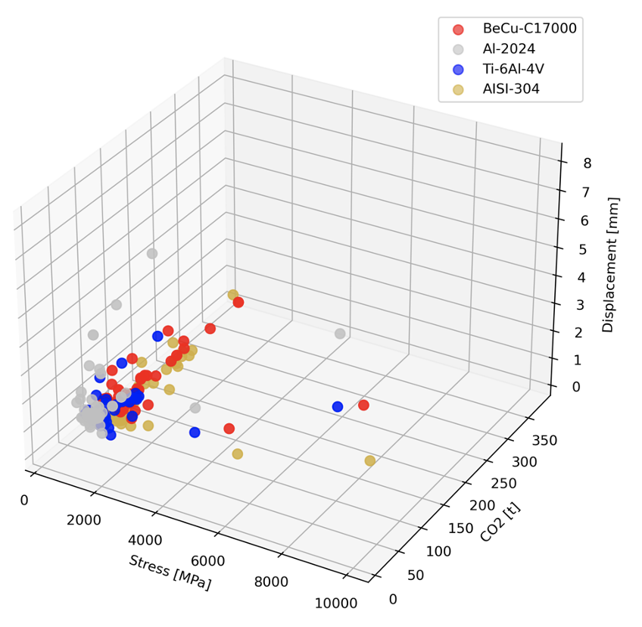
3D Pareto Front
Feasibility of all generations
Possibly under constrained
Fig 15 : Constraint Violation
https://mid2supaero.github.io/TOSM/
Fig 14 : 3D Pareto Front
Notes:
The aim of the surrogate model is being capable of determining a function such as when some inputs are introduced, it can be able tod etermine the CO2. As an inputs we have the materials and the training data. For the inputs it would be the materials and their properties and some other parameters that are needed to be able to optimize the problem. The final goal is to find a plot in which we can find the deformation – CO2 emmited. For our project we intend to do 200 simulated samples with 5 or 6 materials each. Due to the high number of simulations we will use the High Performance Computer of ISAE SUPAERO. In the surrogate we will use a method included in the SMT library like a Bayessian optimization method .
First the CAD file will need to be optimized for 4 load cases and the deformations will be computed.

Slide 21

Possible Lines of Work
Surrogate modelling
Increase material database
Continuous optimization
Add features website
Notes:
The aim of the surrogate model is being capable of determining a function such as when some inputs are introduced, it can be able tod etermine the CO2. As an inputs we have the materials and the training data. For the inputs it would be the materials and their properties and some other parameters that are needed to be able to optimize the problem. The final goal is to find a plot in which we can find the deformation – CO2 emmited. For our project we intend to do 200 simulated samples with 5 or 6 materials each. Due to the high number of simulations we will use the High Performance Computer of ISAE SUPAERO. In the surrogate we will use a method included in the SMT library like a Bayessian optimization method .
First the CAD file will need to be optimized for 4 load cases and the deformations will be computed.

Slide 22
Conclusions
Comprehensive Database
Extended SimJEB to integrate mechanical and environmental impact of materials.
Decoupled Optimization:
Material- specific design is essential.
Pareto-Optimal Solutions:
NSGA-2 MOO solution, balancing mechanical performance and environmental footprint
Interactive Tool:
Web based design tool for dynamic exploration of results

Slide 23
References
[1] Whalen, E., Beyene, A. and Mueller, C. (2021), SimJEB: Simulated Jet Engine Bracket Dataset. Computer Graphics Forum, 40: 9-17.
[2] Edouard Duriez, Joseph Morlier, Catherine Azzaro-Pantel, M. Charlotte. Ecodesign with topology optimization. Procedia CIRP, 2022, 109, pp.454-459. 10.1016/j.procir.2022.05.278 . hal-03722152
[3] Asai, Gustavo (2023), Ecodesign and 3D topology optimisation. ISAE-SUPAERO.
[4] Blank, J., “Pymoo: Multi-objective optimization in Python”, 2020. URL https://pymoo.org/algorithms/moo/nsga2.html#nb-nsga2
[5] Luis Yepes Llorente, et al. “A Hybrid Machine Learning and Evolutionary Approach to Material Selection and Design Optimization for Eco-Friendly Structures.” Structural and Multidisciplinary Optimization, vol. 67, no. 5, 1 May 2024, https://doi.org/10.1007/s00158-024-03777-z. Accessed 18 June 2024.

